Slide 1


TELCOMUNDO
BIENVENIDOS

Slide 2







www.yourdomain.com
Use name
password
Registrar
Olvide La Clave
TELCOMUNDO

Slide 3
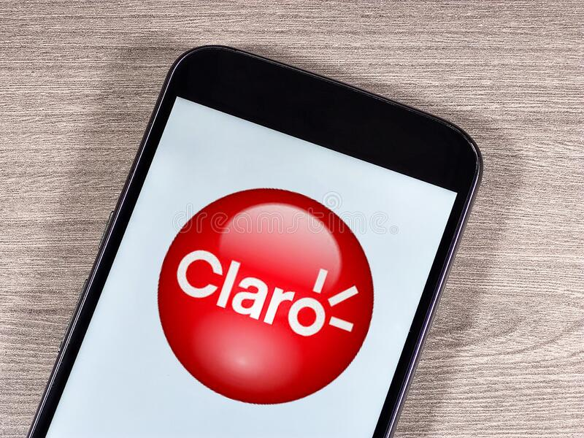
ALL ITEM
SHOP NOW

Slide 4
CYBER
MONDAY
70%
OFF
Sed no sale recusabo maluisset, eu cum malorum tacimates. Sint expetenda maiestatis.
SHOP NOW

Slide 5
COLLECTION
www.yourdomain.com

Slide 6
COLLECTION
SHOP NOW

Slide 7
70%
OFF
COLLE
CTION
SHOP NOW

